Slide 1
Visual Voyagers
Estella Chen, Citlali Haro Franco, Nick Nguyen, Annie Ren, Vivian Vo
Bringing Social Interaction to Virtual Reality Through Visual Engagement
Estella Chen, Citlali Haro Franco, Nick Nguyen, Annie Ren, Vivian Vo

Slide 2


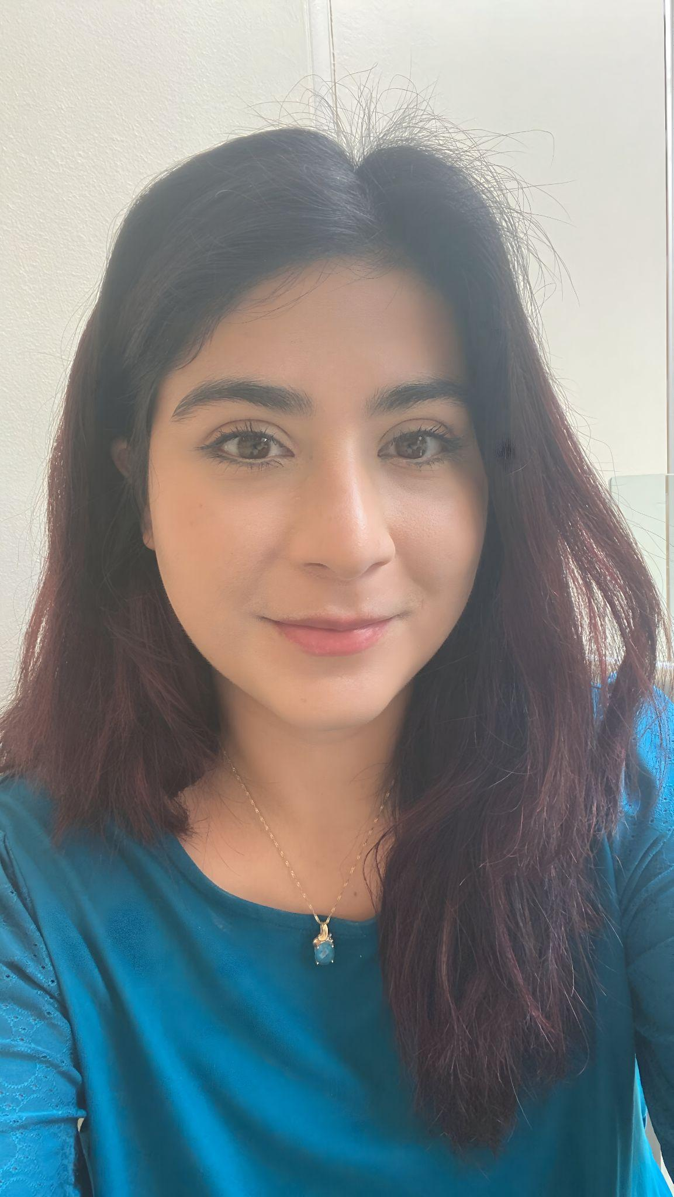



Meet the Team
Estella Chen
Citlali Haro Franco
Nick Nguyen
Annie Ren
Vivian Vo

Slide 3
Overview
The Problem
Problem Background
User Stories
Needs Statement
Goals and Objectives
Constraints
System Overview
Demos
Backend Logic
Validation & User Testing Results
Testing Results
Evaluation Process
User Feedback
Alternative Product Solutions
Conclusion
References
Questions

Slide 4
The Problem

Slide 5


Problem Background
Feeling disconnected from people you were once close to? Has the distance between you and your loved one only feel like it was growing further and further apart?
Notes:
How about with your grandparents? Or an old friend?

Slide 6


Notes:
Jason
Young in college
always using social media
Loves new ways to connect with friends
Chris
Grandfather
Wants to connect meaningfully with his grandson than just talking over a phone

Slide 7

Common Features
Want to connect across long distances
Want to build stronger relations with their loved ones
Want to interact in some engaging or meaningful way

Slide 8
Needs Statement
Users want a shared space where they can meet up with some loved ones.
Users want to be able to reminisce memories together in an immersive way.

Slide 9
Goals and Objectives
Goals
Create a VR social space that:
Emphasizes images/memories and how you can interact with them
Facilitates connections between people
Objectives
Immersive experiences
Viewing photos using VR
Multiplayer
Communication feature

Slide 10
Constraints
Constraints
Performance | Our program needs to achieve at least 90 frames per second (FPS) for an enjoyable experience and meet the minimum hardware requirements
Hardware Compatibility | Because our project needs to achieve 90 FPS, we must restrict the types of devices to run our program on.
Program Runtime | Our app needs to be able to run for at least 30 minutes without crashing or consuming too much battery to allow for prolonged interactions
Internet Connection | Users will need an internet connection in order to use multiplayer

Slide 11
System Overview

Slide 12
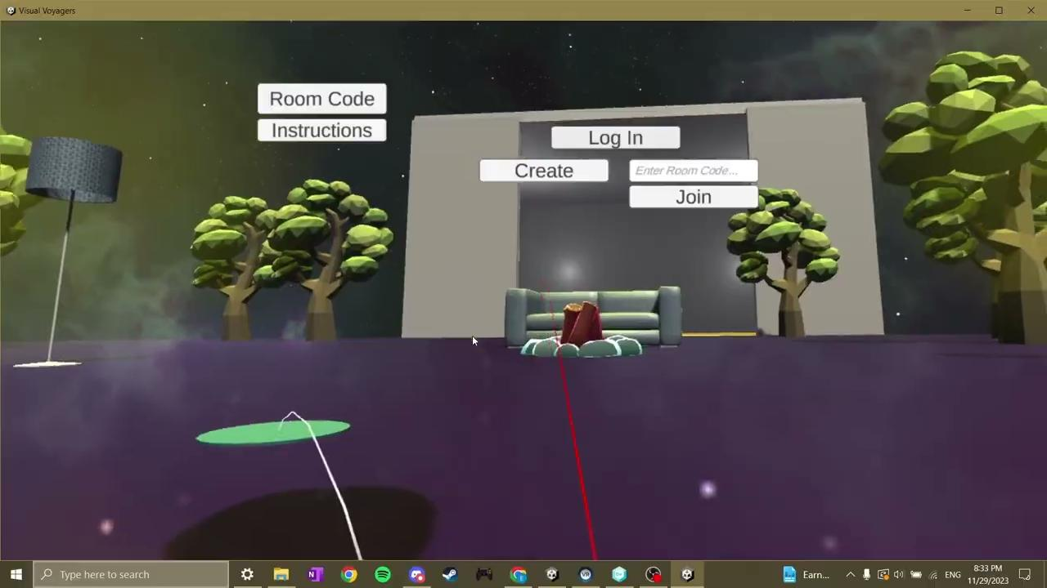
Demo for Gallery & OAuth

Slide 13
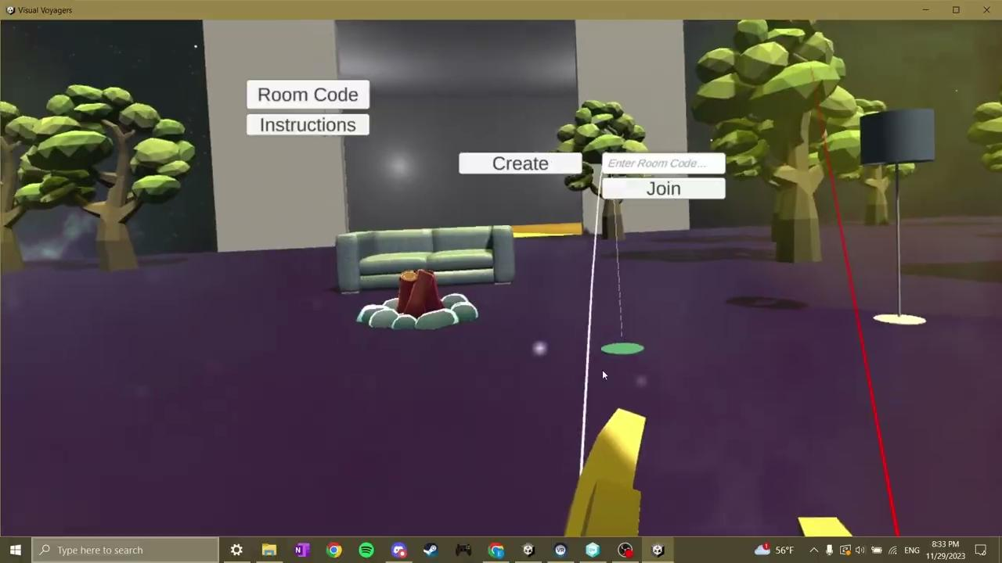
Demo for Multiplayer & Vivox

Slide 14

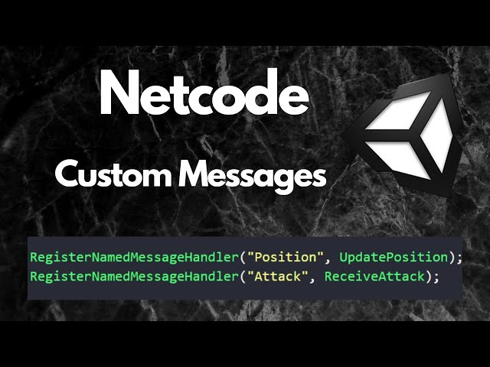




Design

Slide 15



Backend Logic
Create
HTTP Requests
Relay
Create
Game data
Game data
Authorization Code/Access Token
Unity Relay Transport
Client
API Requests
Host
Processed Voice Data
Voice Data
Photo Information
Voice Data
Google Photos

Slide 16
Backend Logic (Multiplayer)
Create
HTTP Requests
Relay
Create
Game data
Game data
Authorization Code/Access Token
Unity Relay Transport
Client
API Requests
Host
Processed Voice Data
Voice Data
Photo Information
Voice Data
Google Photos

Slide 17
Backend Logic (Photo Retrieval)
Create
HTTP Requests
Relay
Create
Game data
Game data
Authorization Code/Access Token
Unity Relay Transport
Client
API Requests
Host
Processed Voice Data
Voice Data
Photo Information
Voice Data
Google Photos

Slide 18
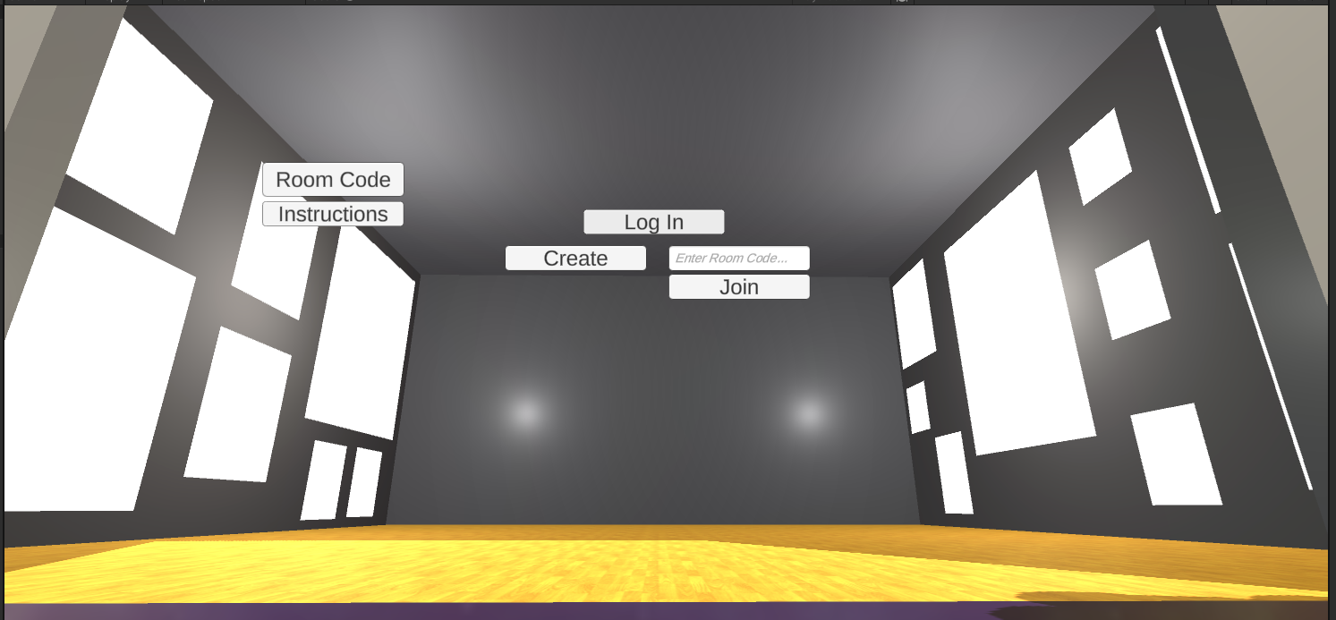
OAuth

Slide 19
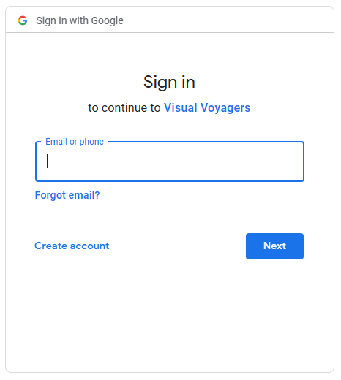
OAuth

Slide 20
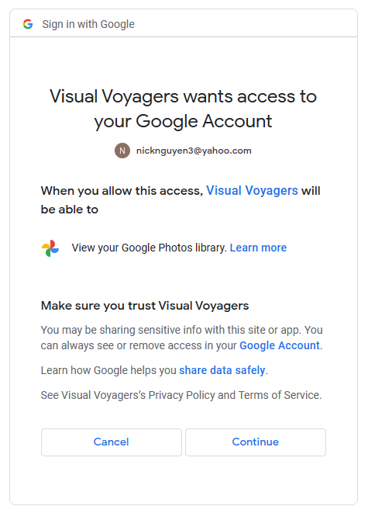
OAuth

Slide 21
OAuth

Slide 22
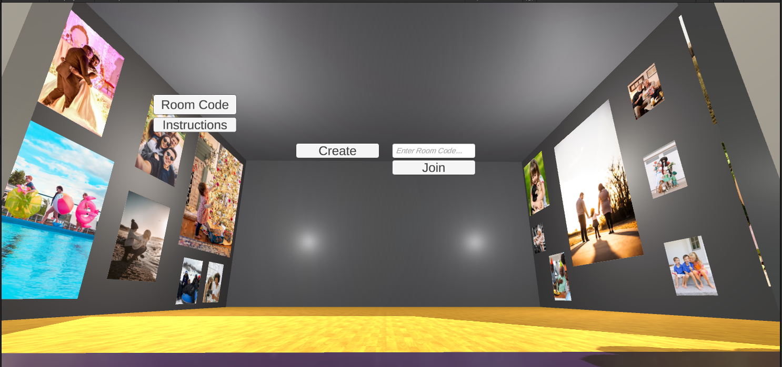
OAuth

Slide 23
Backend Logic (Voice Chat)
Create
HTTP Requests
Relay
Create
Game data
Game data
Authorization Code/Access Token
Unity Relay Transport
Client
API Requests
Host
Processed Voice Data
Voice Data
Photo Information
Voice Data
Google Photos
Notes:
For communication, Unity will handle the capture of voice data. This data is sent to Vivox servers that are responsible for routing, processing, and distributing the data to the correct users, such as the other clients that have connected to the host’s server. Once the client applications have received the data, users can hear and respond to others.

Slide 24
Validation & User Testing Results

Slide 25
Validation Testing Results
Results
FPS Measurement: 90 FPS
Variance Measurement: 15 FPS
Network packet loss < 5%
Users reported no real noticeable lag or synchronization issues with multiplayer and vivox voice chat
Graphics were laggy on laptops without dedicated graphics card
On average there was 15-20 FPS

Slide 26
Evaluation Process
User Interviews
Usability Testing
Walked user through VR controls and logged into Google Photos for them
Allowed user to walk through the outdoor and gallery scene and immerse themselves
User Survey
Asked user for further feedback that may have been missed in testing

Slide 27
User Feedback
Nausea
Difficulty using the program that wasn’t calibrated for HTC Vive headset
Reticule was difficult on other non HTC Vive headsets
Issues with keyboard
Also just kind of slow in general
Glitching
Avatars were hovering plane
Teleportation for the Client side was not as seamless as Host
Issue with Relay Code having to be in all caps (case sensitive)
No Caps lock available

Slide 28
Alternative Product Solution
Users without dedicated GPUs or resources have VR headset compatibility issues
Solution: an emulator specific build that doesn’t require VR headsets
Can be used for emulator to emulator connection
Can be used for emulator to VR headset connection
Build with emulator capabilities will also allow for usage on Macbooks

Slide 29

Final Thoughts

Slide 30
References

Slide 31
"The Importance of Frame Rates." IRISVR. Accessed 25 Sept. 2023, from help.irisvr.com/hc/en-us/articles/215884547-The-Importance-of-Frame-Rates#:~:text=Studies%20have%20shown%20that%20in,all%20times%20in%20their%20software.
"How Do You Optimize VR Healthcare App Performance?" Linkedin. Accessed Sept. 2023, from www.linkedin.com/advice/1/how-do-you-optimize-vr-healthcare-app-performance#:~:text=High%20latency%20can%20cause%20motion,or%20higher%20for%20VR%20apps.
Unity Technologies (2023, June 22). Diagnosing Performance Problems. Unity Learn. Accessed Oct. 28, 2023, from https://learn.unity.com/tutorial/diagnosing-performance-problems-2019-3#

Slide 32
Thank You ⊂((・▽・))⊃

